Slide 1
Space Jam
By: Srilekha Divyakolu & Cynthia Khan

Slide 2
Classification
AWS Rekognition with Python SDK

Slide 3
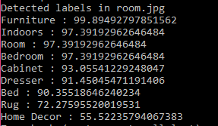
AWS Python Code snippet
imageFile=sys.argv[1]
client=boto3.client('rekognition')
with open(imageFile, 'rb') as image:
response = client.detect_labels(Image={'Bytes': image.read()})
print('Detected labels in ' + imageFile)
for label in response['Labels']:
if (('Bed' in label['Name']) or ('Bedroom' in label['Name'])):
print (label['Name'] + ' : ' + str(round(label['Confidence'],2)))
#print (label)
engine = pyttsx3.init()
engine.say("I am " + str(round(label['Confidence'],2)) + "percent confident that This is a " + label['Name'])
#+ " Its height is " + str(height) + "pixels, and"
#+ " Its width is " + str(width) + "pixels")
engine.runAndWait()

Slide 4
Edge Detection
JOHN F. CANNY

Slide 5
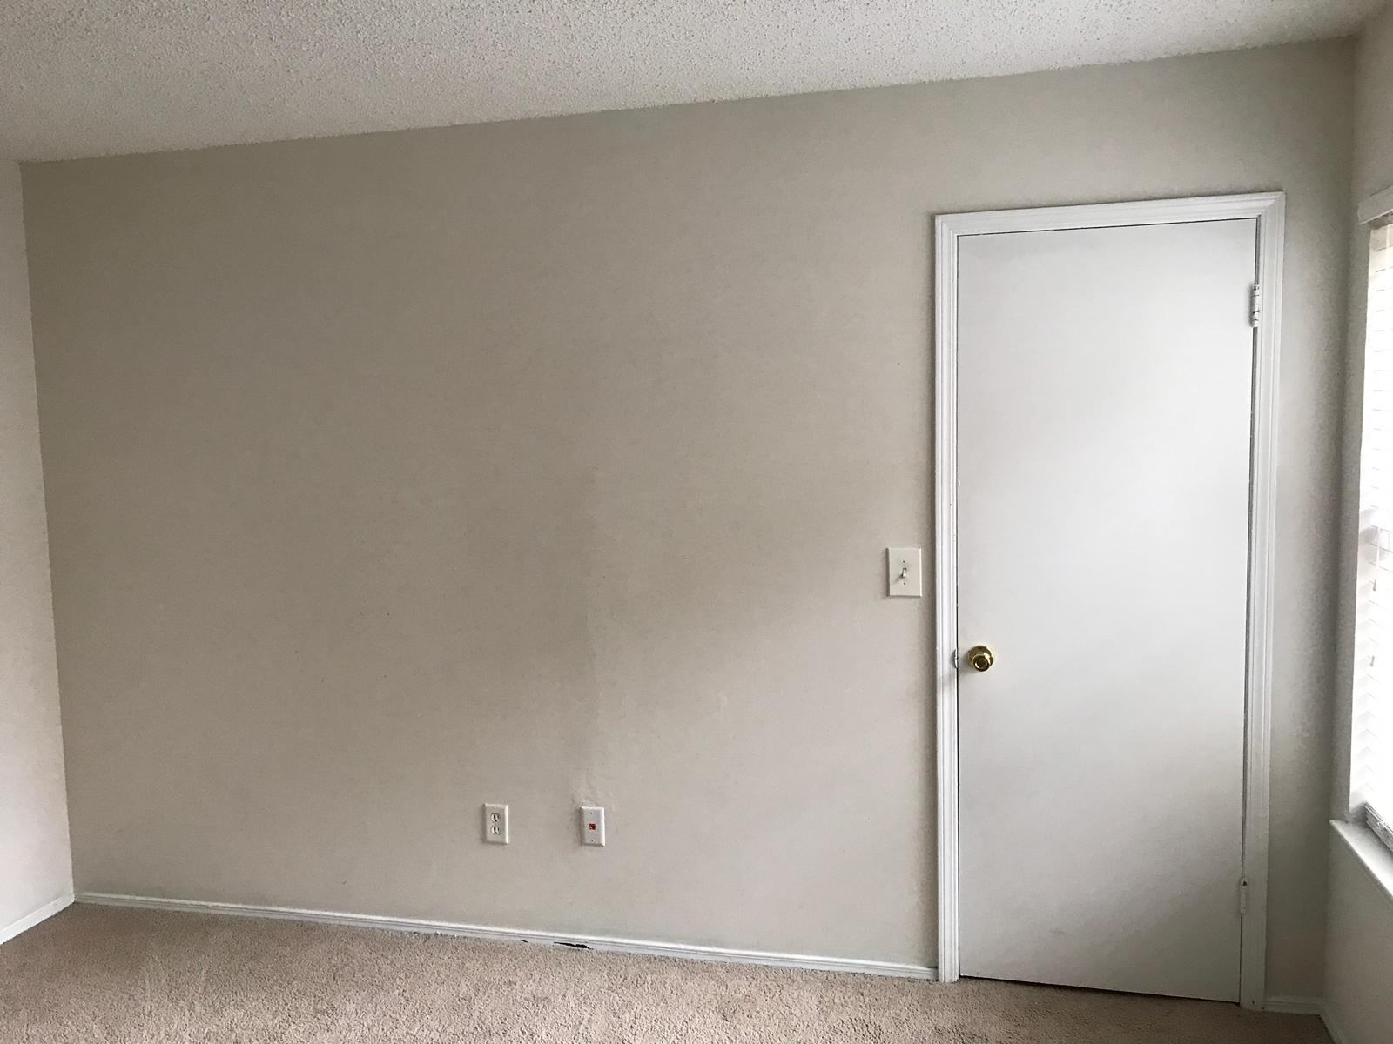
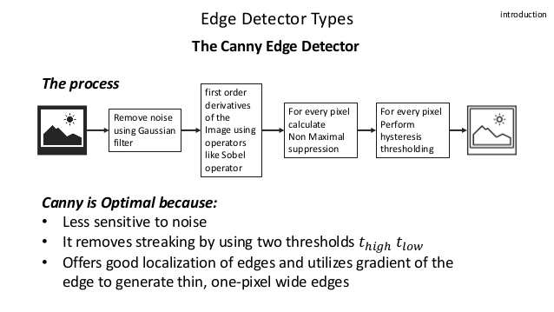
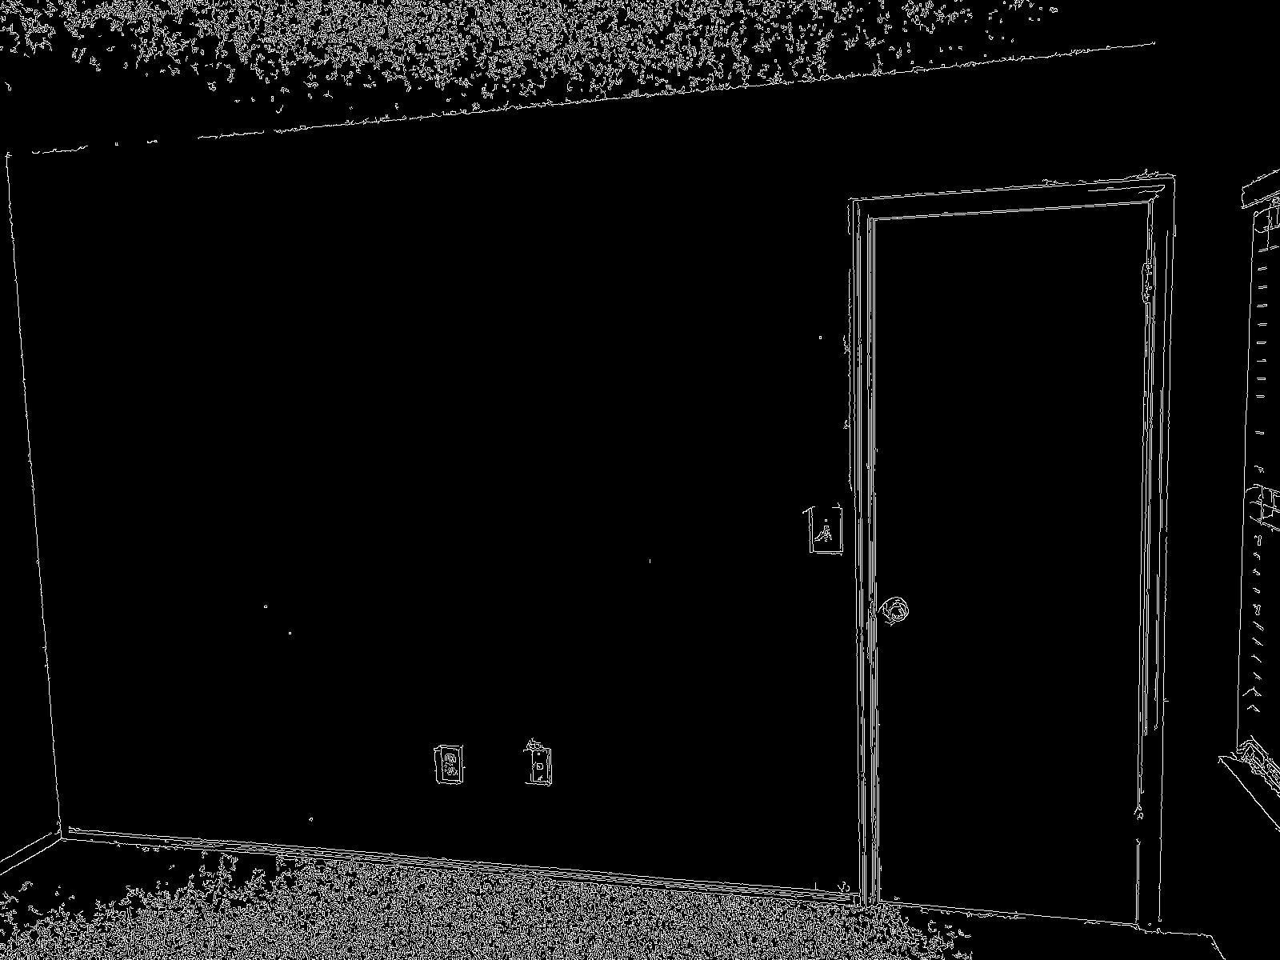
Canny EDGE DETECTION

Slide 6


Dimensionality
Detected object measurement, reference-measurement, height and length of the room measurement
MATLAB and Python 3.6

Slide 7
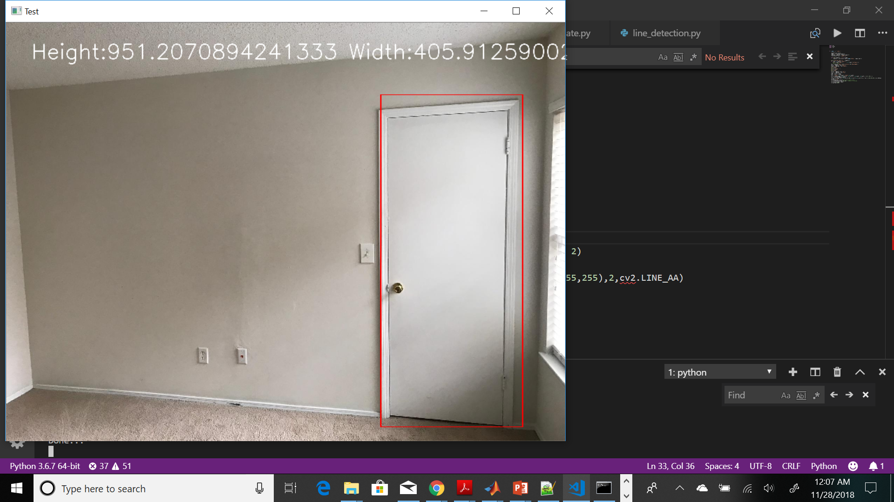

Bounding box computation for objects found
box = response['Labels'][0]['Instances'][0]['BoundingBox']
width = imgWidth * box['Width']
height = imgHeight * box['Height']
startX = imgWidth * box['Left']
startY = imgHeight * box['Top']
endX = startX + width
endY = startY + height
cv2.rectangle(image1, (int(startX), int(startY)), (int(endX), int(endY)), (0, 0, 255), 2)

Slide 8
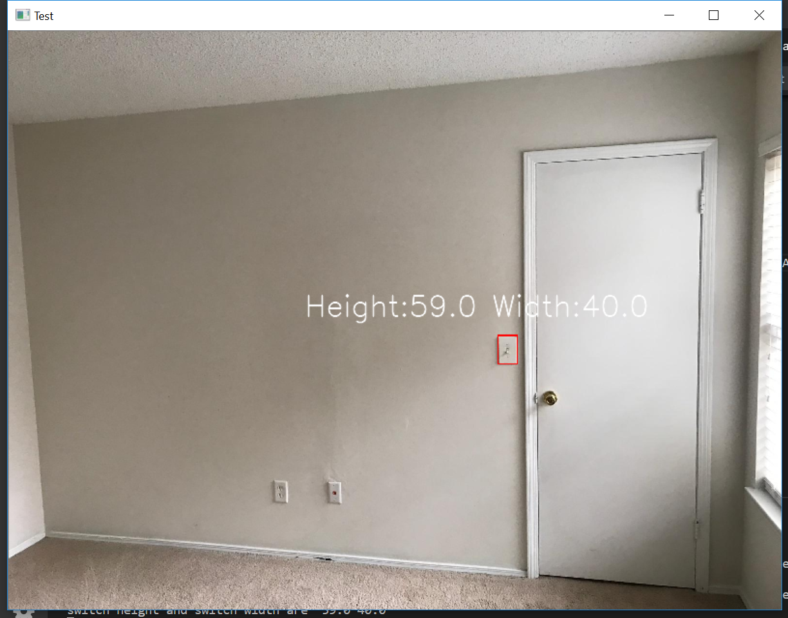
Switch-board detection and Measuring its dimensions
As switch board is not detected as from our object classification using AWS, we used Template matching technique to find it in the picture.
The bounding box is drawn in the original picture where image is matched.
The dimensions height and width of bounding box are taken as reference height and width.

Slide 9
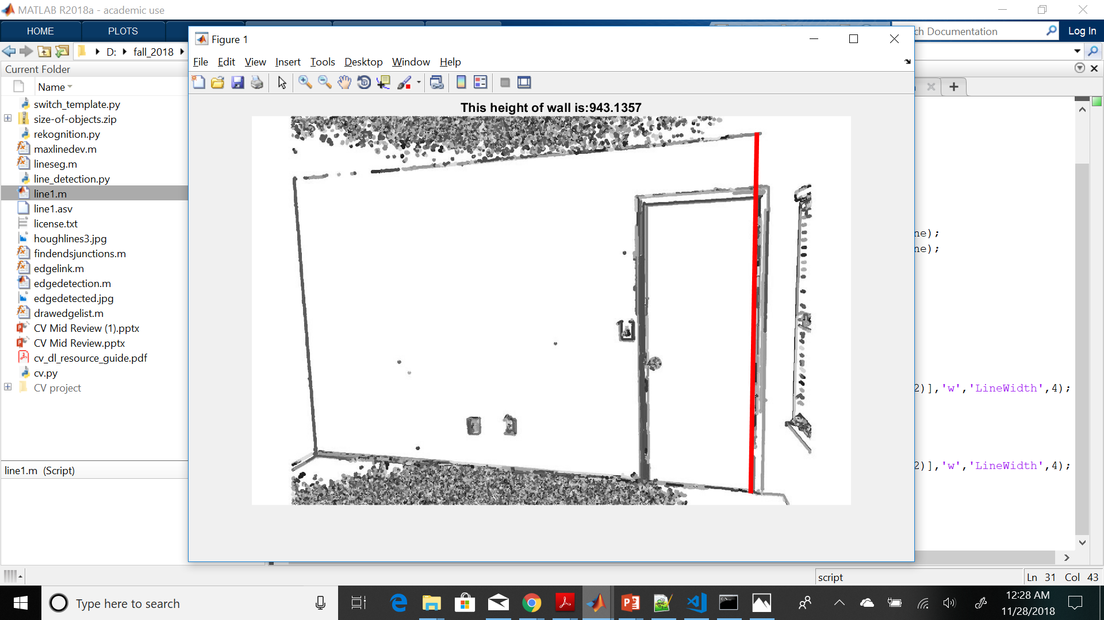
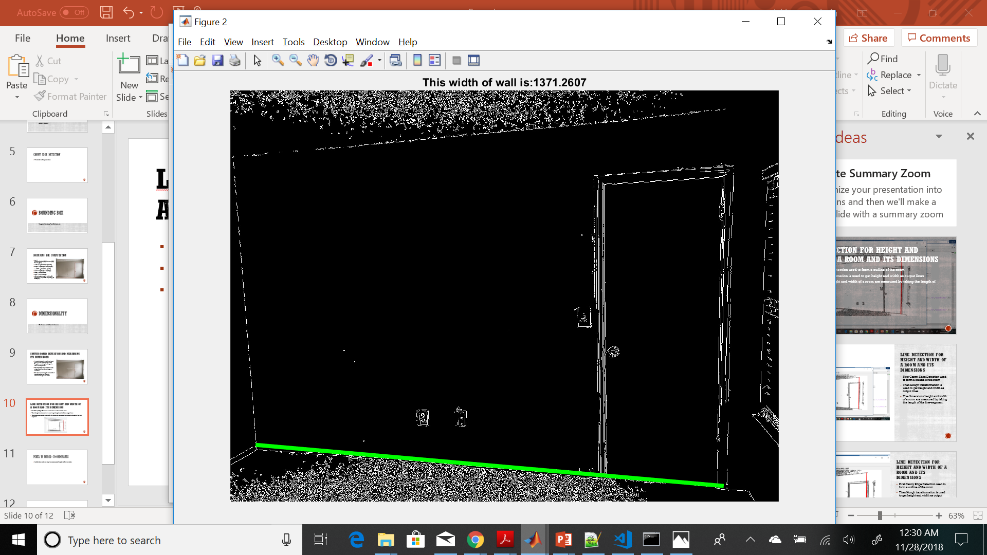
LIne detection for HEIGHT and width of a room and its dimensions
First Canny Edge Detection used to form a outline of the room
Then Hough transformation is used to get height and width as output lines
The dimensions height and width of a room in pixels are measured by taking the length of the line-segment.

Slide 10
Pixel to world co-ordinates Mapping
Height ,width in pixels of room
reference_height = 5.433071; #switch height and width in inches
reference_width = 3.58268;
# switch height and width found in pixels
switch_height, switch_width
height_observed = (height * reference_height)/switch_height;
width_observed = (width* height_observed )/ height;
# to verify the results height and width of the measured room
height_real = 98.897638;
width_real = 157.24409;
# calculate the error-rate to measure the accuracy
height_error_rate = (abs(height_observed - height_real)/height_real)*100;
width_error_rate = (abs(width_observed - width_real)/width_real)*100;

Slide 11
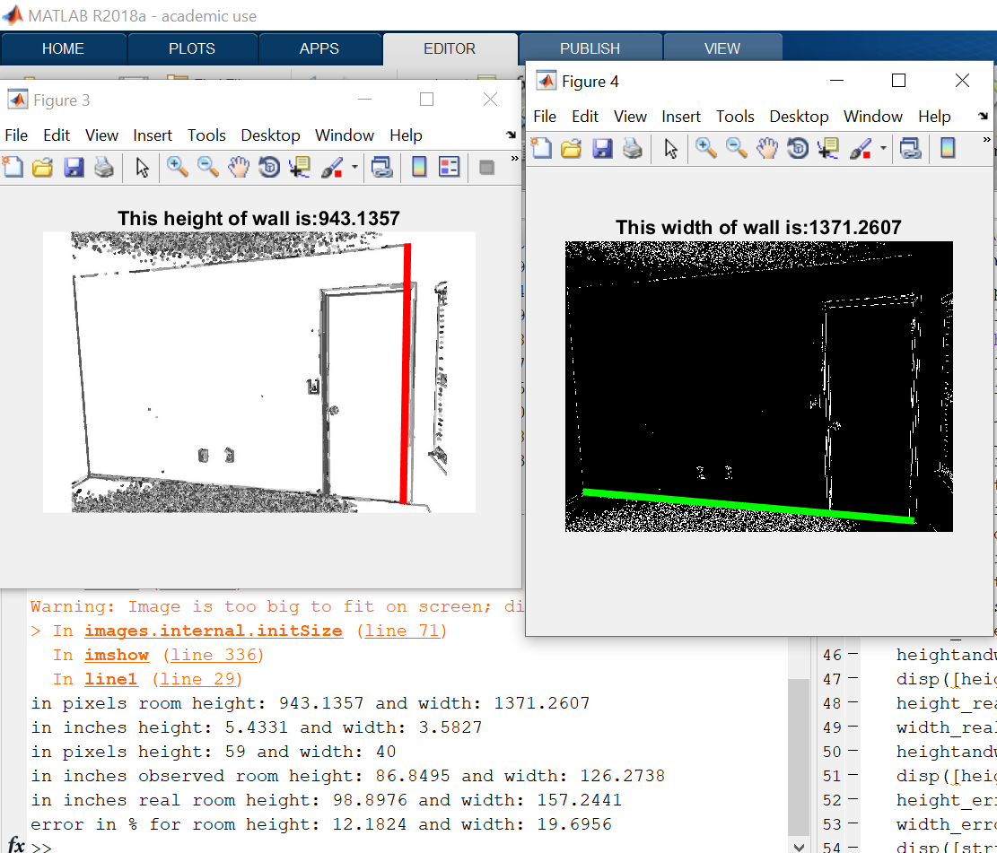
Results for a single Room
From our method and the initial results for a single room we got an accuracy of 88% in measuring height and an accuracy of 81% in measuring length.

Slide 12
Future scope
Finding all dimensions in all rooms in a house and improve the accuracy rate
With each dimension of every room, building a floor-plan of the house.

Slide 13
Thank you
Questions?

